Slide 1

NLP Automation for text classification
Dr. S VIJAY KUMAR - MENTOR
19BTRCR005 – M R NAVEEN KUMAR
19BTRCR018 – A RISHAB VANIGOTHA
19BTRCR023 – K V ABHIRAM
19BTRCR024 – KEERTHI U S
19BTRCR026 – MILAN HUNDIA JAIN

Slide 2
INTRODUCTION
A computer program's capacity to comprehend natural language, or human language as it is spoken and written, is known as natural language processing (NLP). It is a part of machine intelligence (AI).
Natural Language Processing (NLP) is a field of study focused on allowing computers to understand, interpret, and generate human language.
The automation of NLP tasks has become increasingly important as the amount of unstructured text data continues to grow.

Slide 3
INTRODUCTION
The development of web interfaces and tools that simplify and automate NLP tasks is crucial in allowing users to analyze and understand their data without the need for extensive technical knowledge.
NLP is widely used for applications like NER(Named Entity Recognition), Text Classification, Text Generation, Text Mask Prediction etc.
NLP requires a lot of tedious tasks to be done. It requires a lot of effort and time.

Slide 4
Problem Statement
The goal of this project is to develop a web interface using Streamlit that simplifies and automates various Natural Language Processing (NLP) tasks, including Exploratory Data Analysis (EDA), named entity recognition (NER), text classification, masking and other related tasks.
The interface should provide the user with a convenient and user-friendly environment for performing NLP tasks with ease, without requiring extensive knowledge of programming and NLP algorithms.
The aim is to provide a tool that streamlines the NLP workflow, allowing users to focus on the analysis of their data, rather than on technical details.

Slide 5
Objectives
To design and implement a web interface using Streamlit for NLP tasks.
To provide a user-friendly and accessible environment for performing NLP tasks without requiring extensive technical knowledge.
To optimize the NLP workflow for efficiency and effectiveness.
To make NLP more accessible to a wider audience by simplifying the process and reducing the need for technical expertise.

Slide 6
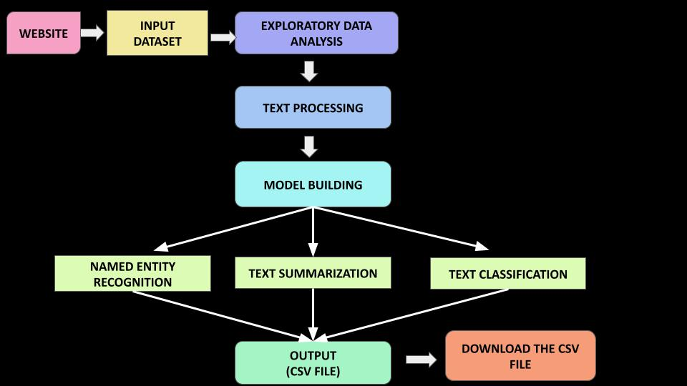
SCHEMATIC DIAGRAM

Slide 7
Base Paper
Title - A Survey on Text Pre-Processing & Feature Extraction Techniques in Natural Language Processing
Authors - Ayisha Tabassum, Dr. Rajendra R. Patil
YOP - 2020, IRJET
Findings - Text preprocessing is a crucial step in improving the accuracy of text-based machine learning algorithms.
Common techniques include tokenization, removal of stopwords and punctuation, and lemmatization.
Feature extraction methods like bag-of-words and TF-IDF are also widely used, with TF-IDF being the preferred method for identifying prominent features and downscaling irrelevant features.
The order of the NLP pipeline can also affect the results. The techniques used and their order may vary depending on the use case.

Slide 8
REFERENCES
[1] Ayisha Tabassum, Dr. Rajendra R. Patil - “A Survey on Text Pre-Processing & Feature Extraction Techniques in Natural Language Processing” - 2020
https://www.irjet.net/archives/V7/i6/IRJET-V7I6913.pdf
[2] Manjusha Pandey Indrashis Das Siddharth S. Rautaray​ bharat sharma - “An Examination System Automation Using Natural Language Processing” - 2020
https://www.researchgate.net/publication/339406698_An_Examination_System_Automation_Using_Natural_Language_Processing​
[3] Eftim Zdravevski, Petre Lameski, Vladimir Trajkovik, Ivan Chorbev, Rossitza Goleva, Nuno Pombo & Nuno M. Garcia - “Automation in Systematic, Scoping and Rapid Reviews by an NLP Toolkit: A Case Study in Enhanced Living Environments” - 2019
https://link.springer.com/chapter/10.1007/978-3-030-10752-9_1#Sec9​
[4] Mohammad Hossein ,Hassan B. Kazemian, Karim Ouazzane, Chris Chandler - “Natural Language Processing approach to NLP Meta model automation” - 2018
http://repository.londonmet.ac.uk/3447/1/Paper.pdf

